Slide 1
ECO102: Introduction to Macroeconomics
Lecturer: Addrita Shams (RTA)
Week 03, Lecture 06
Chapter 23: Economic Growth

Slide 2
The Basics of Economic Growth
Economic growth is a sustained expansion of production possibilities measured as the increase in real GDP over a given period.
Rapid economic growth maintained over a number of years can transform a poor nation into a rich one. Slow economic growth or the absence of growth can condemn a nation to devastating poverty.
Calculating Growth Rates We express the economic growth rate as the annual percentage change of real GDP. To calculate this growth rate, we use the formula:
Real GDP growth rate= [ (Real GDP in current year – Real GDP in previous year)/ (real GDP in previous year) ] x100
The growth rate of real GDP tells us how rapidly the total economy is expanding.
The standard of living depends on real GDP per person (also called per capita real GDP), which is real GDP divided by the population.

Slide 3
How Potential GDP Grows
Economic growth occurs when real GDP increases.
But a one-shot rise in real GDP or a recovery from recession isn’t economic growth. Economic growth is a sustained, year-after-year increase in potential GDP.
Labor, capital, land, and entrepreneurship produce real GDP, and the productivity of the factors of production determines the quantity of real GDP that can be produced.
The quantity of land is fixed and on any given day, the quantities of entrepreneurial ability and capital are also fixed and their productivities are given. The quantity of labor employed is the only variable factor of production.
Potential GDP is the level of real GDP when the quantity of labor employed is the full-employment quantity.
To determine potential GDP, we use a model with two components:
■ An aggregate production function
■ An aggregate labor market

Slide 4
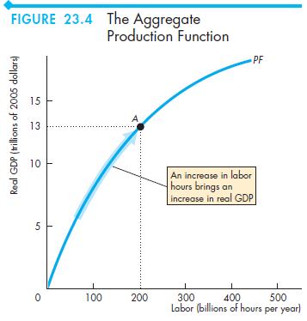
Aggregate Production Function
We’re now going to think about the production possibilities frontier for two special “goods”: real GDP and the quantity of leisure time.
The quantity of leisure time is the number of hours spent not working. If we spent all our time taking leisure, we would do no work and produce nothing. Real GDP would be zero.
The more leisure we forgo, the greater is the quantity of labor we supply and the greater is the quantity of real GDP produced.
The aggregate production function is the relationship that tells us how real GDP changes as the quantity of labor changes when all other influences on production remain the same.

Slide 5
Aggregate Labour Market
The Demand for Labor : The demand for labor is the relationship between the quantity of labor demanded and the real wage rate. The quantity of labor demanded is the number of labor hours hired by all the firms in the economy during a given period.
This quantity depends on the price of labor, which is the real wage rate.
The real wage rate is the money wage rate divided by the price level. The real wage rate is the quantity of goods and services that an hour of labor earns.
The quantity of labor demanded increases as the real wage rate decreases—the demand for labor curve slopes downward.
The Supply of Labor The supply of labor is the relationship between the quantity of labor supplied and the real wage rate.
The quantity of labor supplied is the number of labor hours that all the households in the economy plan to work during a given period.
This quantity depends on the real wage rate.
The real wage rate influences the quantity of labor supplied because what matters to households is not the number of dollars they earn (money wage rate) but what they can buy with those dollars.
The quantity of labor supplied increases as the real wage rate increases—the supply of labor curve slopes upward.

Slide 6
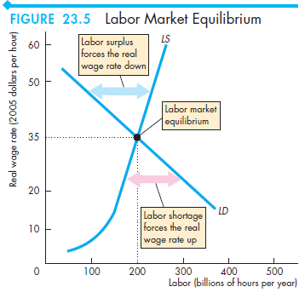
Labour Market Equilibrium
The price of labor is the real wage rate.
The forces of supply and demand operate in labor markets just as they do in the markets for goods and services to eliminate a shortage or a surplus.
A shortage or a surplus of labor brings only a gradual change in the real wage rate.
If there is a shortage of labor, the real wage rate rises to eliminate it; and
if there is a surplus of labor, the real wage rate eventually falls to eliminate it.
When there is neither a shortage nor a surplus, the labor market is in equilibrium— a full-employment equilibrium.
At this equilibrium real wage rate and level of employment, the economy is at full employment.

Slide 7
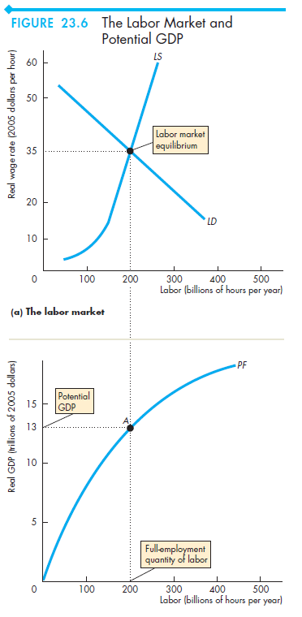
Potential GDP
The quantity of real GDP produced increases as the quantity of labor increases.
At the equilibrium quantity of labor, the economy is at full employment, and the quantity of real GDP at full employment is potential GDP.
So the full-employment quantity of labor produces potential GDP.
We can divide all the forces that make potential GDP grow into two categories:
■ Growth of the supply of labor
■ Growth of labor productivity

Slide 8
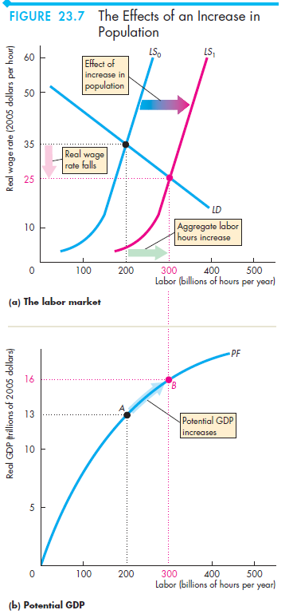
Growth of the Supply of Labor
When the supply of labor grows, the supply of labor curve shifts rightward. The quantity of labor at a given real wage rate increases.
The quantity of labor is the number of workers employed multiplied by average hours per worker; and
the number employed equals the employment-to-population ratio multiplied by the working-age population.
So the quantity of labor changes as a result of changes in
1. Average hours per worker
2. The employment-to-population ratio
3. The working-age population

